Slide 1
Team 7 – Predicting Response to Online Apartment Listings Ahmet Hatip, Ellie Lan, Di Qin, Scott Smith, Shuming Sun April 20th 2018

Slide 2
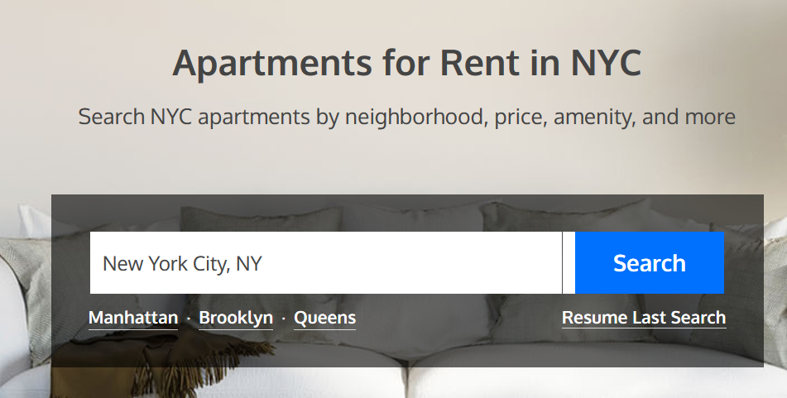
Introduction
Client: RentHop is an online rental listing company operating in New York City
Objective: Classify each rental listing according to the projected number of inquiries it will receive. This will allow RentHop to improve inquiry rate for their clients.
Challenges
Ordinal Response Variable (High, Medium, Low)
Unbalanced Classes
No zip codes: Latitude and Longitude
Text Data
Image Data

Slide 3

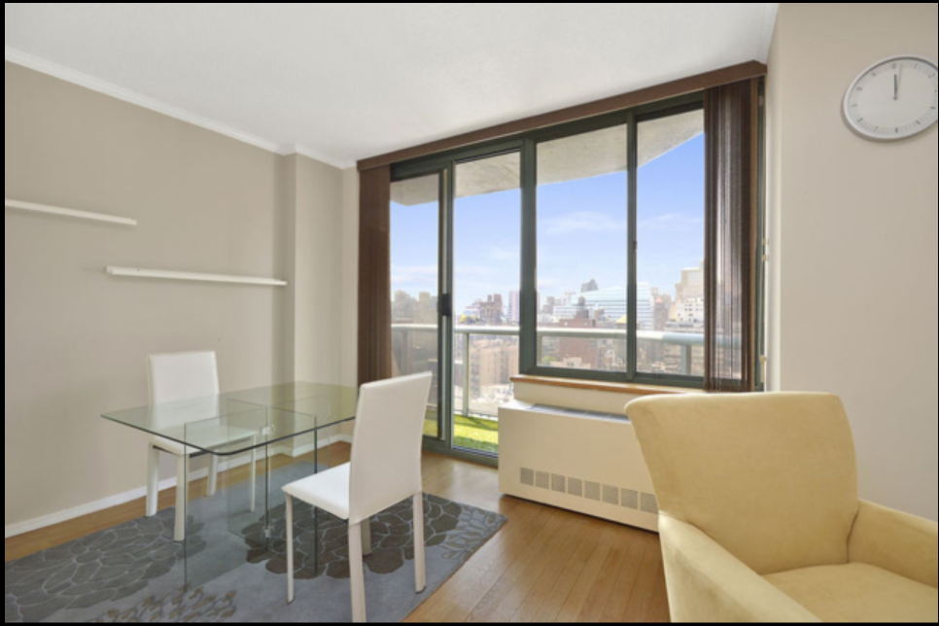

Data
Directly Usable
Bathrooms
Bedrooms
Monthly Rent
Feature Engineering Required
Text Description
Apartment Characteristics
Latitude
Longitude
URLs for Images
Response
Observations

Slide 4
Simplifying Assumptions
Response Variable
Ordinal and unbalanced classes did not yield acceptable results in timeframe
Assumed client would find value in classifying ‘low’ vs. ‘medium/high’, so we switched to binary classification
Address Data
No zip code available, so NLP would be required
NLP is already being used to analyze description via sentiment analysis, but timeframe did not allow for address analysis
Used latitude and longitude to capture location signal
Tried geographic clustering, but this did not improve results

Slide 5
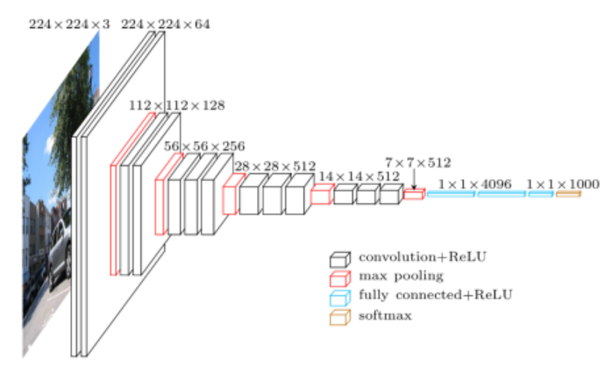
Feature Engineering: Image processing
Each listing had a set of urls for images
Based upon the literature, we chose to use the first image
Used already trained VGG16 model in Keras package to extract 1,000 features
Each feature had a value between 0 and 1 and corresponded to ImageNet categories
Used PCA to extract 95% of variance in 61 Principal Components

Slide 6
Feature Engineering: Image processing
Each listing had a set of urls for images
Based upon the literature, we chose to use the first image
Used already trained VGG16 model in Keras package to extract 1,000 features
Each feature had a value between 0 and 1 and corresponded to ImageNet categories
Used PCA to extract 95% of variance in 61 Principal Components
Future Work: Train an aesthetic model on top of existing base model layers

Slide 7
Feature Engineering: NLP
Sentiments
Positive sentiment
Negative sentiment
Overall valence = positive sentiment + negative sentiment
NRC Word-Emotion Association Lexicon
14,182 unigrams
Emotions:
anger, anticipation, disgust, fear, joy, sadness, surprise, trust
Notes:
Syuzhet is a russian word and it means the use of narrative in a story. It's also the name of the R package we used to do sentiment analysis on the apartment descriptions. Similar to a narrative, apartment descriptions contain certain emotions in the form of joy, trust. Often brokers won't express disgust or sadness in a listing, but they will certainly try to conjure positive emotions from people who are looking to rent places. What this package allowed us to do is to assign each listing a score on each of the 8 emotions as well as a total score in terms of positive sentiment and negative sentiment. The result is an ordered rank of each apartment description that allowed us to carry out probit analysis on the overall sentiment as well as each of the emotions.

Slide 8
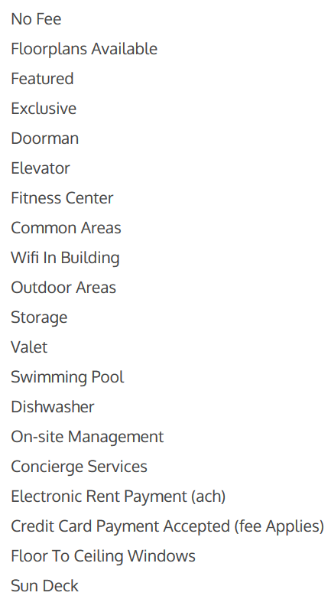
Feature Engineering: Apartment Characteristics
Over 1000 different characteristics listed
Manually combined similar characteristics (e.g. ‘Hardwood’ and ‘Hardwood Floors’)
Chose top 152 characteristics, each used in at least ten listings
Converted free text to 152 features, each with 0 or 1.

Slide 9


Modelling: Logistic Regression
Objective:
Classify low vs. medium /high
Try L1 and L2 regularization separately
Used raw data and also under-sampled data (due to unbalanced classes)
Lambdas selected using 5-fold cross-validation
Results:
L1 regularization yielded good results
L2 regularization did not yield good results
Unbalanced Classes (Raw Data)
Balanced Classes (Under-sampled Data)
Accuracy: 0.75
Accuracy Low: 0.89
Accuracy Med/High: 0.44
AUC: 0.83
219/225 variables
Accuracy: 0.70
Accuracy Low: 0.66
Accuracy Med/High: 0.79
AUC: 0.83
218 out of 225 variables

Slide 10

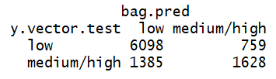
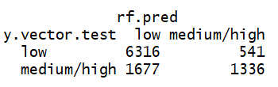
Modelling: Tree Based Methods
Decision Tree
Bagging
Random Forest
Accuracy: 0.73
Accuracy Low: 0.96
Accuracy Med/High: 0.19
AUC: 0.73
Accuracy: 0.78
Accuracy Low: 0.89
Accuracy Med/High: 0.54
AUC: 0.84
Accuracy: 0.78
Accuracy Low: 0.92
Accuracy Med/High: 0.44
AUC: 0.83

Slide 11
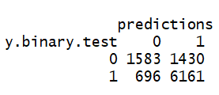
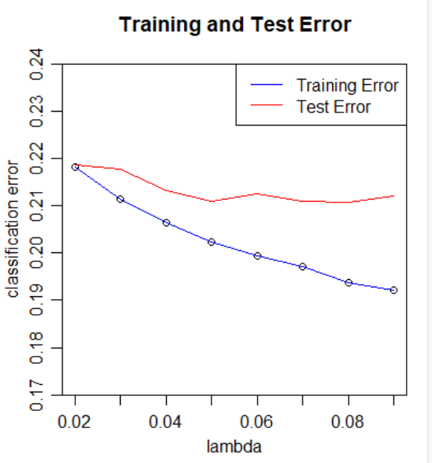
Modelling: Boosting
Boosting without cluster (1=‘low’, 0 = ‘medium/high’, lambda=0.05)
Accuracy: 0.78
Accuracy Low: 0.90
Accuracy Med/High: 0.53
AUC: 0.84

Slide 12
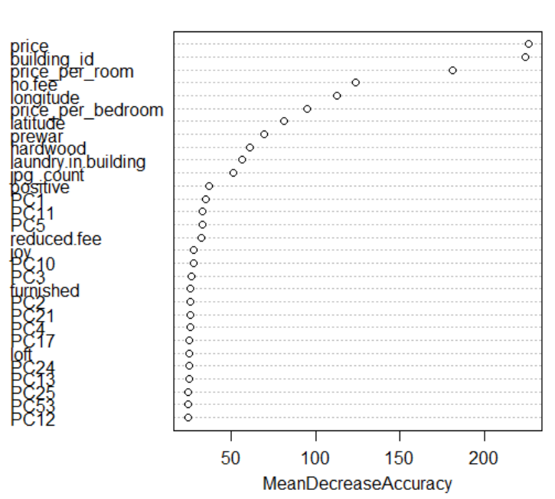
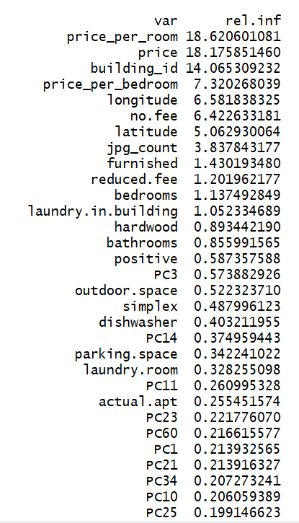
Most Important Variables
Bagging
Boosting

Slide 13
Conclusions
Boosting and bagging yielded the highest overall accuracy, AUC and a reasonable balance of accuracy across the two classes
Logistic regression with under-sampling yielded the best balance of accuracy across the two classes but had reduced overall accuracy due to less training data
The ‘Best Model’ depends upon the business objectives
If all errors have equal cost, select boosting
If ‘medium/high’ errors have higher cost, consider logistic regression
For other cost tradeoffs, consider all models
Most important features:
Monthly rent
Geographic cluster
Sentiment in description: joy, trust
11 out of 1000 image features
Number of bedrooms

Slide 14
Recommended Work to Improve Model
Replace ImageNet model with ascetic model (for images)
Use text modelling to extract features from ‘address’ column
Iterate over combinations of L1 and L2 penalties to find best logistic regression model (Elastic Net)
Consider over-sampling to balance the classes
Try varying the prediction thresholds to get better characteristics
Do ordinal classification

